Slide 1
Chapter Five
Risk Management

Slide 2
Introduction
What can go wrong?
What is the likelihood?
What will the damage be?
What can we do about it?

Slide 3
Definition
Risks are events or conditions that may occur, and whose occurrence, if it does take place, has a harmful or negative effect.
  Defects are not risks. They are almost certain.
  Risks are probabilistic events.
Anything worth doing has risks. The challenge is not to avoid them but to manage them.
Conceptual definition of risk
  Risk concerns future happenings
  Risk involves change in mind, opinion, actions, places, etc.
  Risk involves choice and the uncertainty that choice entails
It is generally caused due to lack of information, control or time.
Risk Management is an attempt to minimize the chances of failure caused by unplanned events.

Slide 4
Software Risk
A possibility of suffering from loss in software development process is called a software risk.
Loss can be anything, increase in production cost, development of poor quality software, not being able to complete the project on time.
Software risk exists because the future is uncertain and there are many known and unknown things that cannot be incorporated in the project plan.
A software risk can be of two types:
  (1) Internal risks that are within the control of the project manager.
  (2) External risks that are beyond the control of project manager.

Slide 5
Cont’d
There are basic risks that are generic to almost all software projects.
A software project may encounter various types of risks:
Technical risks
  Include problems with languages, project size, project functionality, platforms, methods, standards, or processes.
  These risks may result from excessive constraints, lack of experience, poorly defined parameters, or dependencies on organizations outside the direct control of the project team.
Management risks
  Include lack of planning, lack of management experience and training, communications problems, organizational issues, lack of authority, and control problems.

Slide 6
Cont’d
Financial risks
  Include cash flow, capital and budgetary issues, and return on investment constraints.
Contractual and legal risks
  Include changing requirements, market-driven schedules, health & safety issues, government regulation, and product warranty issues.
Personnel risks
  Include staffing lags, experience and training problems, ethical and moral issues, staff conflicts, and productivity issues.
Other resource risks
  Include unavailability or late delivery of equipment and supplies, inadequate tools, inadequate facilities, distributed locations, unavailability of computer resources, and slow response times.

Slide 7
Cont’d
On the other hand, risks can be categorized as:
Known risks
  Those risks that can be uncovered after careful evaluation of the project plan, the business and technical environment in which the project is being developed, and other reliable information sources (e.g., unrealistic delivery date)
Predictable risks
  Those risks that are extrapolated from past project experience (e.g., past turnover)
Unpredictable risks
  Those risks that can and do occur, but are extremely difficult to identify in advance

Slide 8
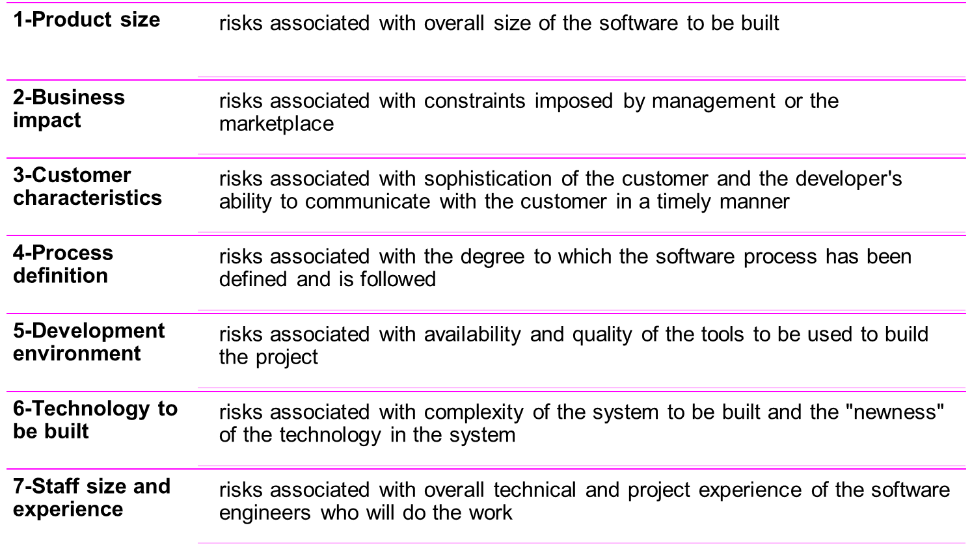
Known and Predictable Risks

Slide 9
Reasons for Implementing
Software Risk Management
With risk management the “emphasis is shifted from crisis management to anticipatory management”.
Boehm defines four major reasons for implementing SRM
  Avoiding software project disasters,
    Including run away budgets and schedules, defect-ridden software products, and operational failures.
  Avoiding rework caused by erroneous, missing, or ambiguous requirements, design or code,
    Which typically consume 40-50% of the total cost of software development.
  Avoiding overkill with detection and prevention techniques in area of minimal or no risk.
  Stimulating a win-win software solution where the customer receives the product they need and the vendor makes the profits they expect .

Slide 10

Reactive vs. Proactive Risk Strategies
Reactive risk strategies:
  "Don't worry, I'll think of something"
  The majority of software teams and managers rely on this approach.
  Nothing is done about risks until something goes wrong
    The team then flies into action in an attempt to correct the problem rapidly (fire fighting).
  Crisis management is the choice of management techniques.
Proactive risk strategies:
  Steps for risk management are followed.
  Primary objective is to avoid risk and to have a contingency plan in place to handle unavoidable risks in a controlled and effective manner.

Slide 11
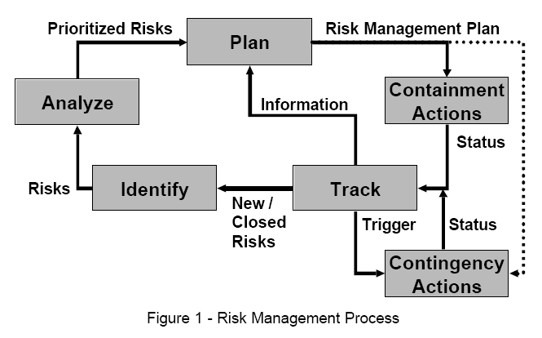
Risk Management Process

Slide 12
Cont’d
Risk Management can broadly divided
  Risk Assessment
    Identification
    Analysis
    Prioritization
  Risk Control
    Planning
    Resolution
    Monitoring
    Correction (usually considered part of monitoring)

Slide 13
Risk Identification
During the first step in the software risk management process, risks are identified and added to the list of known risks.
The output of this step is a list of project-specific risks that have the potential of compromising the project's success.
There are many techniques for identifying risks, including interviewing, reporting, decomposition, assumption analysis, critical path analysis, and utilization of risk taxonomies.

Slide 14
Risk Identification Techniques
Interviewing/Brainstorming:
  with project personnel, customers, and vendors.
  Open-ended questions such as the following can help identify potential areas of risk.
    What new or improved technologies does this project implement?
    What interfaces issues still need to be defined?
    What requirements exist that we aren’t sure how to implement?
Voluntary Reporting:
  where any individual who identifies a risk is encouraged and rewarded for bringing that risk to management’s attention.

Slide 15
Cont’d
Decomposition:
  As the product is being decomposed during the requirements and design phases, another opportunity exists for risk identifications. Every TBD ("To Be Done/Determined") is a potential risk.
  As Ould states, “The most important thing about planning is writing down what you don’t know, because what you don’t know is what you must find out” [Ould-90].
  Decomposition in the form of work breakdown structures during project planning can also help identify areas of uncertainty that may need to be recorded as risks.
Assumption Analysis:
  Process and product assumptions must be analyzed.
  For example, we might assume the hardware would be available by the system test date or three additional experienced C++ programmers will be hired by the time coding starts. If these assumptions prove to be false, we could have major problem.

Slide 16
Cont’d
Critical Path Analysis:
  As we perform critical path analysis for our project plan, we must remain on the alert to identify risks.
  Any possibility of schedule slippage on the critical path must be considered a risk because it directly impacts our ability to meet schedule.
Risk Taxonomies:
  Risk taxonomies are lists of problems that have occurred on other projects and can be used as checklists to help ensure all potential risks.

Slide 17
Questionnaire on Project Risk
Questions are ordered by their relative importance to project success.
  Have top software and customer managers formally committed to support the project?
  Are end-users enthusiastically committed to the project and the system/product to be built?
  Are requirements fully understood by the software engineering team and its customers?
  Have customers been involved fully in the definition of requirements?
  Do end-users have realistic expectations?
  Is the project scope stable?

Slide 18
Cont’d
  Does the software engineering team have the right mix of skills?
  Are project requirements stable?
  Does the project team have experience with the technology to be implemented?
  Is the number of people on the project team adequate to do the job?
  Do all customer/user constituencies agree on the importance of the project and on the requirements for the system/product to be built?

Slide 19
Cont’d
Boehm's Top 10 Software Risks
  1. Schedules, budgets, process
  2. Requirements Changes
  3. Personnel Shortfalls
  4. Requirements Mismatch
  5. Rapid change
  6. Architecture, performance, quality, distribution/mobility
  7. External components
  7. Legacy Software
  9. Externally-performed tasks
  10. User interface mismatch

Slide 20
Risk Analysis
During the risk analysis step, each risk is assessed to determine:
  Likelihood: the probability that the risk will result in a loss.
  Impact: the size or cost of that loss if the risk turns into a problem.
  Timeframe: when the risk needs to be addressed (i.e., risk associated with activities in the near future would have a higher priority then similar risks in later activities).
  The interrelationships between risks are assessed to determine if compounding risk conditions magnify losses.

Slide 21
Cont’d
Boehm defines the Risk Exposure equation to help quantitatively establish risk priorities [Boehm-89].
Risk Exposure measures the impact of a risk in terms of the expected value of the loss.
Risk Exposure (RE) is defined as the probability of an undesired outcome times the expected loss if that outcome occurs.
  RE = Probability (UO) * Loss (UO), where UO = Unexpected outcome

Slide 22
Risk Table
A risk table provides a project manager with a simple technique for risk projection
It consists of five columns
  Risk Summary – short description of the risk
  Risk Category – one of seven risk categories
  Probability – estimation of risk occurrence based on group input
  Impact – (1) catastrophic (2) critical (3) marginal (4) negligible
  RMMM – Risk Mitigation, Monitoring, and Management Plan
Risk Summary | Risk Category | Probability | Impact (1-4) | RMMM

Slide 23
Developing a Risk Table
List all risks in the first column (by way of the help of the risk item checklists)
Mark the category of each risk
Estimate the probability of each risk occurring
Assess the impact of each risk based on an averaging of the four risk components to determine an overall impact value
Sort the rows by probability and impact in descending order
Draw a horizontal cutoff line in the table that indicates the risks that will be given further attention.

Slide 24
Assessing Risk Impact
Three factors affect the consequences that are likely if a risk does occur
  Its nature – This indicates the problems that are likely if the risk occurs
  Its scope – This combines the severity of the risk (how serious was it) with its overall distribution (how much was affected)
  Its timing – This considers when and for how long the impact will be felt
The overall risk exposure formula is RE = P x C
  P = the probability of occurrence for a risk
  C = the cost to the project should the risk actually occur
Example
  P = 80% probability that 18 of 60 software components will have to be developed
  C = Total cost of developing 18 components is $25,000
  RE = .80 x $25,000 = $20,000

Slide 25
Risk Prioritization
The list of risks is then prioritized based on the results of our risk analysis.
Since resource limitations rarely allow the consideration of all risks, the prioritized list of risks is used to identify risks requiring additional planning and action.
Other risks are documented and tracked for possible future consideration.
Based on changing conditions, additional information, the identification of new risks, or the closure of existing risks, the list of risks requiring additional planning and action may require periodic updates.

Slide 26
Risk Management Planning
Taking the prioritized risk list as input, plans are developed for the risks chosen for action.
Next Figure shows the specific questions that can be asked to help focus on the type of planning required.
Two Example risks to illustrate the types of actions that might be taken using each risk handling technique:
  The subcontractor may not deliver the software at the required reliability level and as a result the reliability of the total system may not meet performance specifications.
  The interface with the new control device is not defined and as a result its driver may take more time to implement then scheduled.

Slide 27
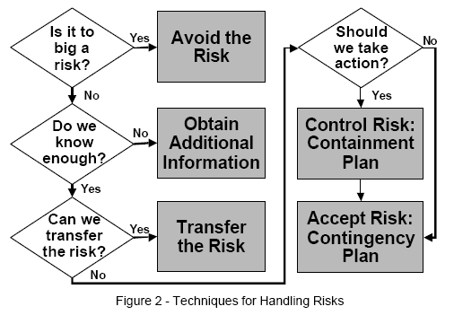
Cont’d

Slide 28
Cont’d
Is it too big a risk?
  If the risk is too big for us to be willing to accept,
  we can avoid the risk by changing our project
  strategies and tactics to choose a less risky alternate or we may decide not to do the project at all
Things to remember about avoiding risks include:
  Avoiding risks may also mean avoiding opportunities
  Not all risks can be avoided
  Avoiding a risk in one part of the project may create risks in other parts of the project

Slide 29
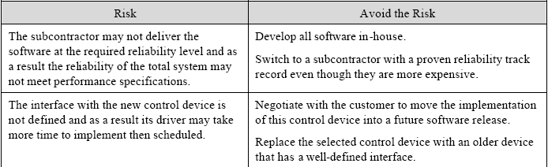
Cont’d

Slide 30
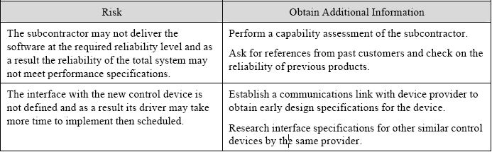
Cont’d
Do we know enough?
  If we don’t know enough, we can plan to “buy” additional information through mechanisms
  such as prototyping, modeling, simulation, or conducting additional research.

Slide 31
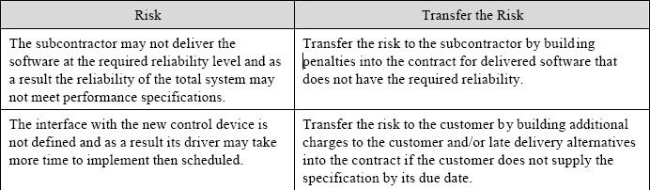
Cont’d
Can we transfer the risk?
  If it is not our risk or if it is economically feasible to pay someone else to assume all or part of the risk, we can plan to transfer the risk to another organization.
  For example we can contract with a disaster recovery firm to provide backup computer facilities that will allow continuation of the project in case a fire or other disaster destroys the project's work environment.

Slide 32
Cont’d
Should action be taken now?
  If we decide to attack the risk directly, we typically start with creating a list of possible risk reduction actions that can be taken for the risk.
  Two major types of risk reduction actions should be considered:
    1. Actions that reduce the likelihood that the risk will occur
    2. Actions that reduce the impact of the risk should it occur
These may include actions such as establishing a liaison with the customer to insure adequate communications, conducting a performance simulation, or buying additional equipment for the test bed to duplicate the operational environment.

Slide 33
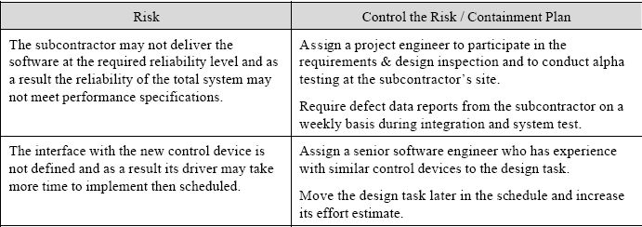
Cont’d

Slide 34
Cont’d
Contingency plan
  If immediate risk reduction actions are not taken or if those actions reduce but do not eliminate the risk, it may be appropriate to develop risk contingency plans.
  plans that are implemented only if the risk actually turns into a problem. Examples of contingency plans include disaster recovery plans, contacting a consulting firm to establish a fallback position if key personnel are not available, or selecting an alternative design approach if the new technology is not delivered as promised.

Slide 35
Cont’d
Each risk that has a contingency plan should also have a trigger.
  A trigger is a time or event in the future that is the earliest indication that the risk will turn into a problem. For example, if there is a risk that outsourced software will not be delivered on schedule, the trigger could be whether the critical design review was held on schedule.
  A trigger can also be a relative variance or threshold metric. For example, if the risk is the availability of key personnel for the coding phase, the trigger could be a relative variance of more than 10% between actual and planned staffing levels.

Slide 36
Cont’d
There are trade-offs in utilizing triggers in risk management.
We want to set the trigger as early as possible in order to ensure that there is plenty of time to implement risk reduction actions.
We also want to set the trigger as late as possible because the longer we wait, the more information we have to make a correct decision and not implement unnecessary actions.

Slide 37
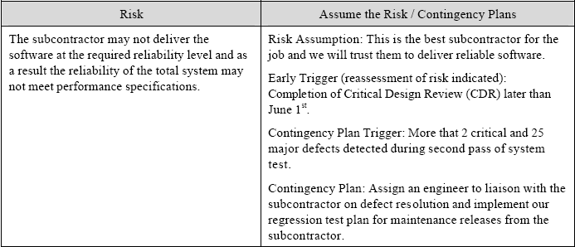
Cont’d

Slide 38
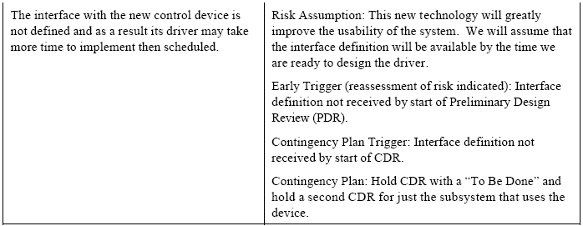
Cont’d

Slide 39
Cont’d
Adjusting the project plan:
  Each selected action in the risk handling plans must include a description of the action and a list of tasks with assigned responsibilities and due dates.
  These actions must be integrated into the project plan with effort and cost estimations.
Project schedules must be adjusted to include these new actions.
  For example, new tasks such as creating prototypes, doing research or conducting alpha testing at the customer’s site must be included in the project plan.

Slide 40
Tracking
Results and impacts of the risk reduction implementation must be tracked.
  The tracking step involves gathering data, compiling that data into information, and then reporting and analyzing that information. This includes measuring known risks and monitoring triggers, as well as measuring the impacts of risk reduction activities.
  The results of the tracking can be:
    Identification of new risks that need to be added to the risk list.
    Validation of known risk resolutions so risks can be removed from the risk list because they are no longer a threat to project success.
    Information that dictates additional planning requirements
    Implementation of contingency plan

Slide 41
Cont’d
Many of the software metrics typically used to manage software projects can also be used to track risks.
  For example, Gantt charts, earned value measures, and budget and resource metrics can help identify and track risks involving variances between plans and actual performance.
  Requirements churn, defect identification rates, and defect backlogs can be used to track rework risks, risks to the quality of the delivered product, and even schedule risks.

Slide 42
Seven Principles of Risk Management
Maintain a global perspective
View software risks within the context of a system and the business problem that is intended to solve
Take a forward-looking view
Think about risks that may arise in the future; establish contingency plans
Encourage open communication
Encourage all stakeholders and users to point out risks at any time
Integrate risk management
Integrate the consideration of risk into the software process
Emphasize a continuous process of risk management
Modify identified risks as more becomes known and add new risks as better insight is achieved
Develop a shared product vision
A shared vision by all stakeholders facilitates better risk identification and assessment
Encourage teamwork when managing risk
Pool the skills and experience of all stakeholders when conducting risk management activities

